Slide 1


Barcoding Bioinformatics
Part III
Jason Williams
Cold Spring Harbor Laboratory, DNA Learning Center
williams@cshl.edu
@JasonWilliamsNY

Slide 2
Barcoding Bioinformatics Part III (Sequence alignment and phylogenetics)

Slide 3
Steps for today’s session
Recap on our experimental dataset
Review of BLAST
Introduction to multiple alignment
Introduction to phylogenetic trees

Slide 4
Recap of the dataset

Slide 5
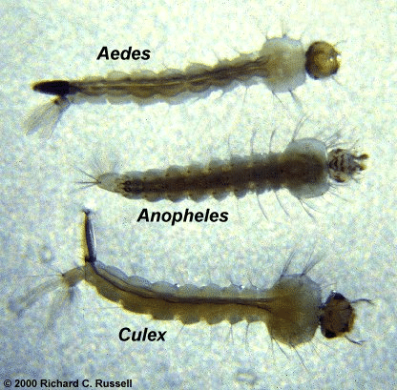

Slide 6
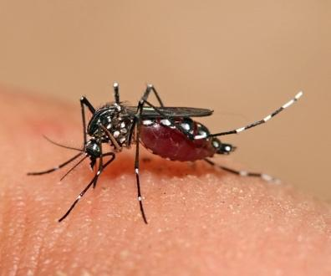
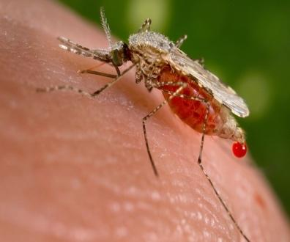
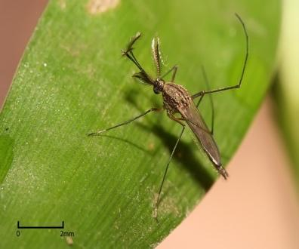
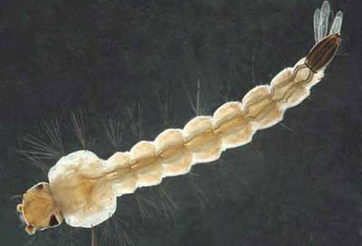
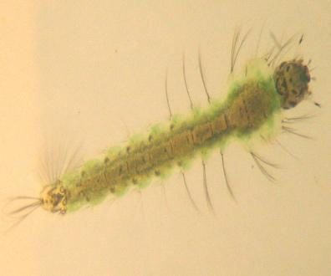
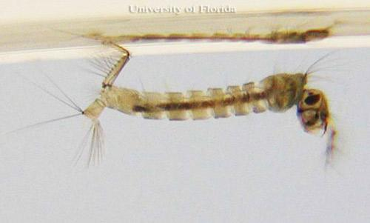
Aedes adult | Anopheles adult | Culex adult
By Muhammad Mahdi Karim - Own work, GFDL 1.2, https://commons.wikimedia.org/w/index.php?curid=11185617 | By Jim Gathany - (PHIL), ID #5814. https://commons.wikimedia.org/w/index.php?curid=799284 | By Muhammad Mahdi Karim - Own work, GFDL 1.2, https://commons.wikimedia.org/w/index.php?curid=7673048
Aedes larva | Anopheles larva | Culex larva
Photograph by Michele M. Cutwa, University of Florida. |  | Photograph by Michelle Cutwa-Francis, University of Florida.

Slide 7
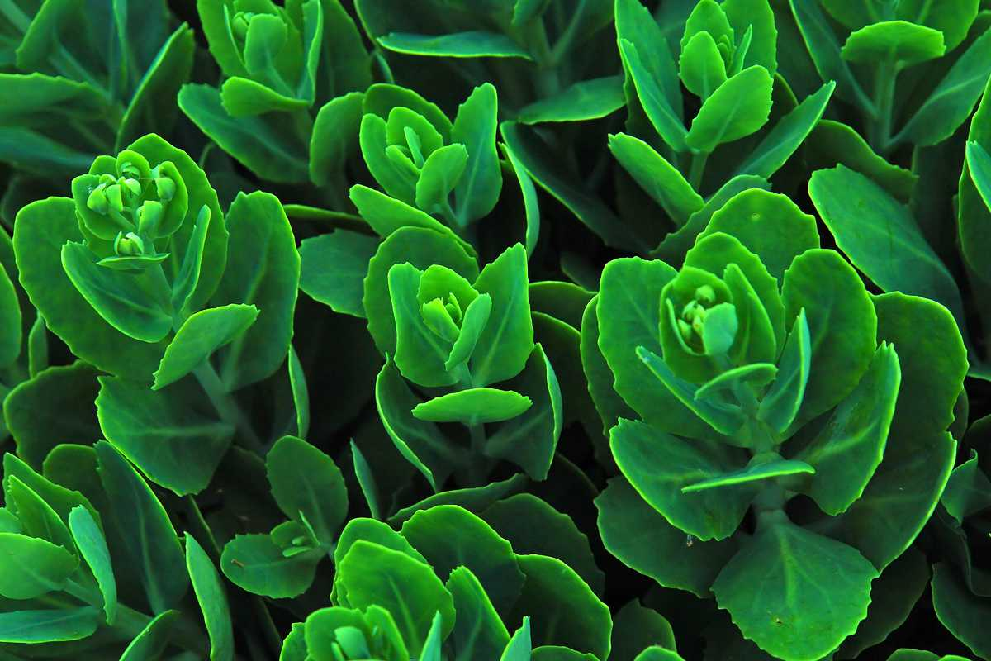



Steps to DNA Barcoding
Organism is sampled DNA is extracted “Barcode” amplified
ACGAGTCGGTAGCTGCCCTCTGACTGCATCGAATTGCTCCCCTACTACGTGCTATATGCGCTTACGATCGTACGAAGATTTATAGAATGCTGCTACTGCTCCCTTATTCGATAACTAGCTCGATTATAGCTACGATG
Sequenced DNA is compared with DNA in a barcode database

Slide 8
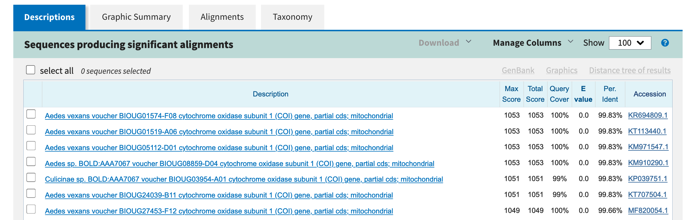
Let’s do a BLAST

Slide 9
Basic Local Alignment Search Tool
An algorithm for searching a database of sequences
“Google for DNA” (although works with any biological sequence, and started before Google ~1990 vs 1998)
NCBI is the most popular interface, but this is software that can be run anywhere (including Subway)

Slide 10
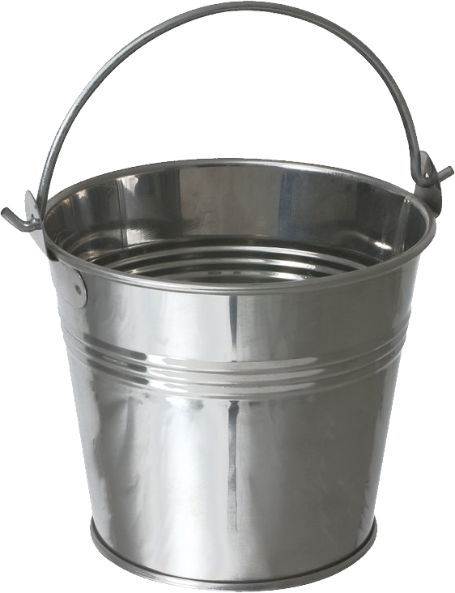
BLAST algorithm analogy
Query sequence
ACTGACATCGGGGTGCTACG
ACTGTGCTAAC
TGCTAACTGAC
TGCTAACTGAG
TGCTAACTGAG
TGCTAACTGAG
ACTGTGCTAAC
TGCTAACTAC
Database

Slide 11
Where in the DNA should we look for the “Barcode”?

Slide 12

Where in the DNA should we look?
Humans share greater than 99% of their DNA with other humans
Photo Credit:
https://www.broadinstitute.org/files/styles/landing_page/public/generic-pages/images/circle/MPG-mosaic_385x300.png?itok=B5zrVgYz

Slide 13
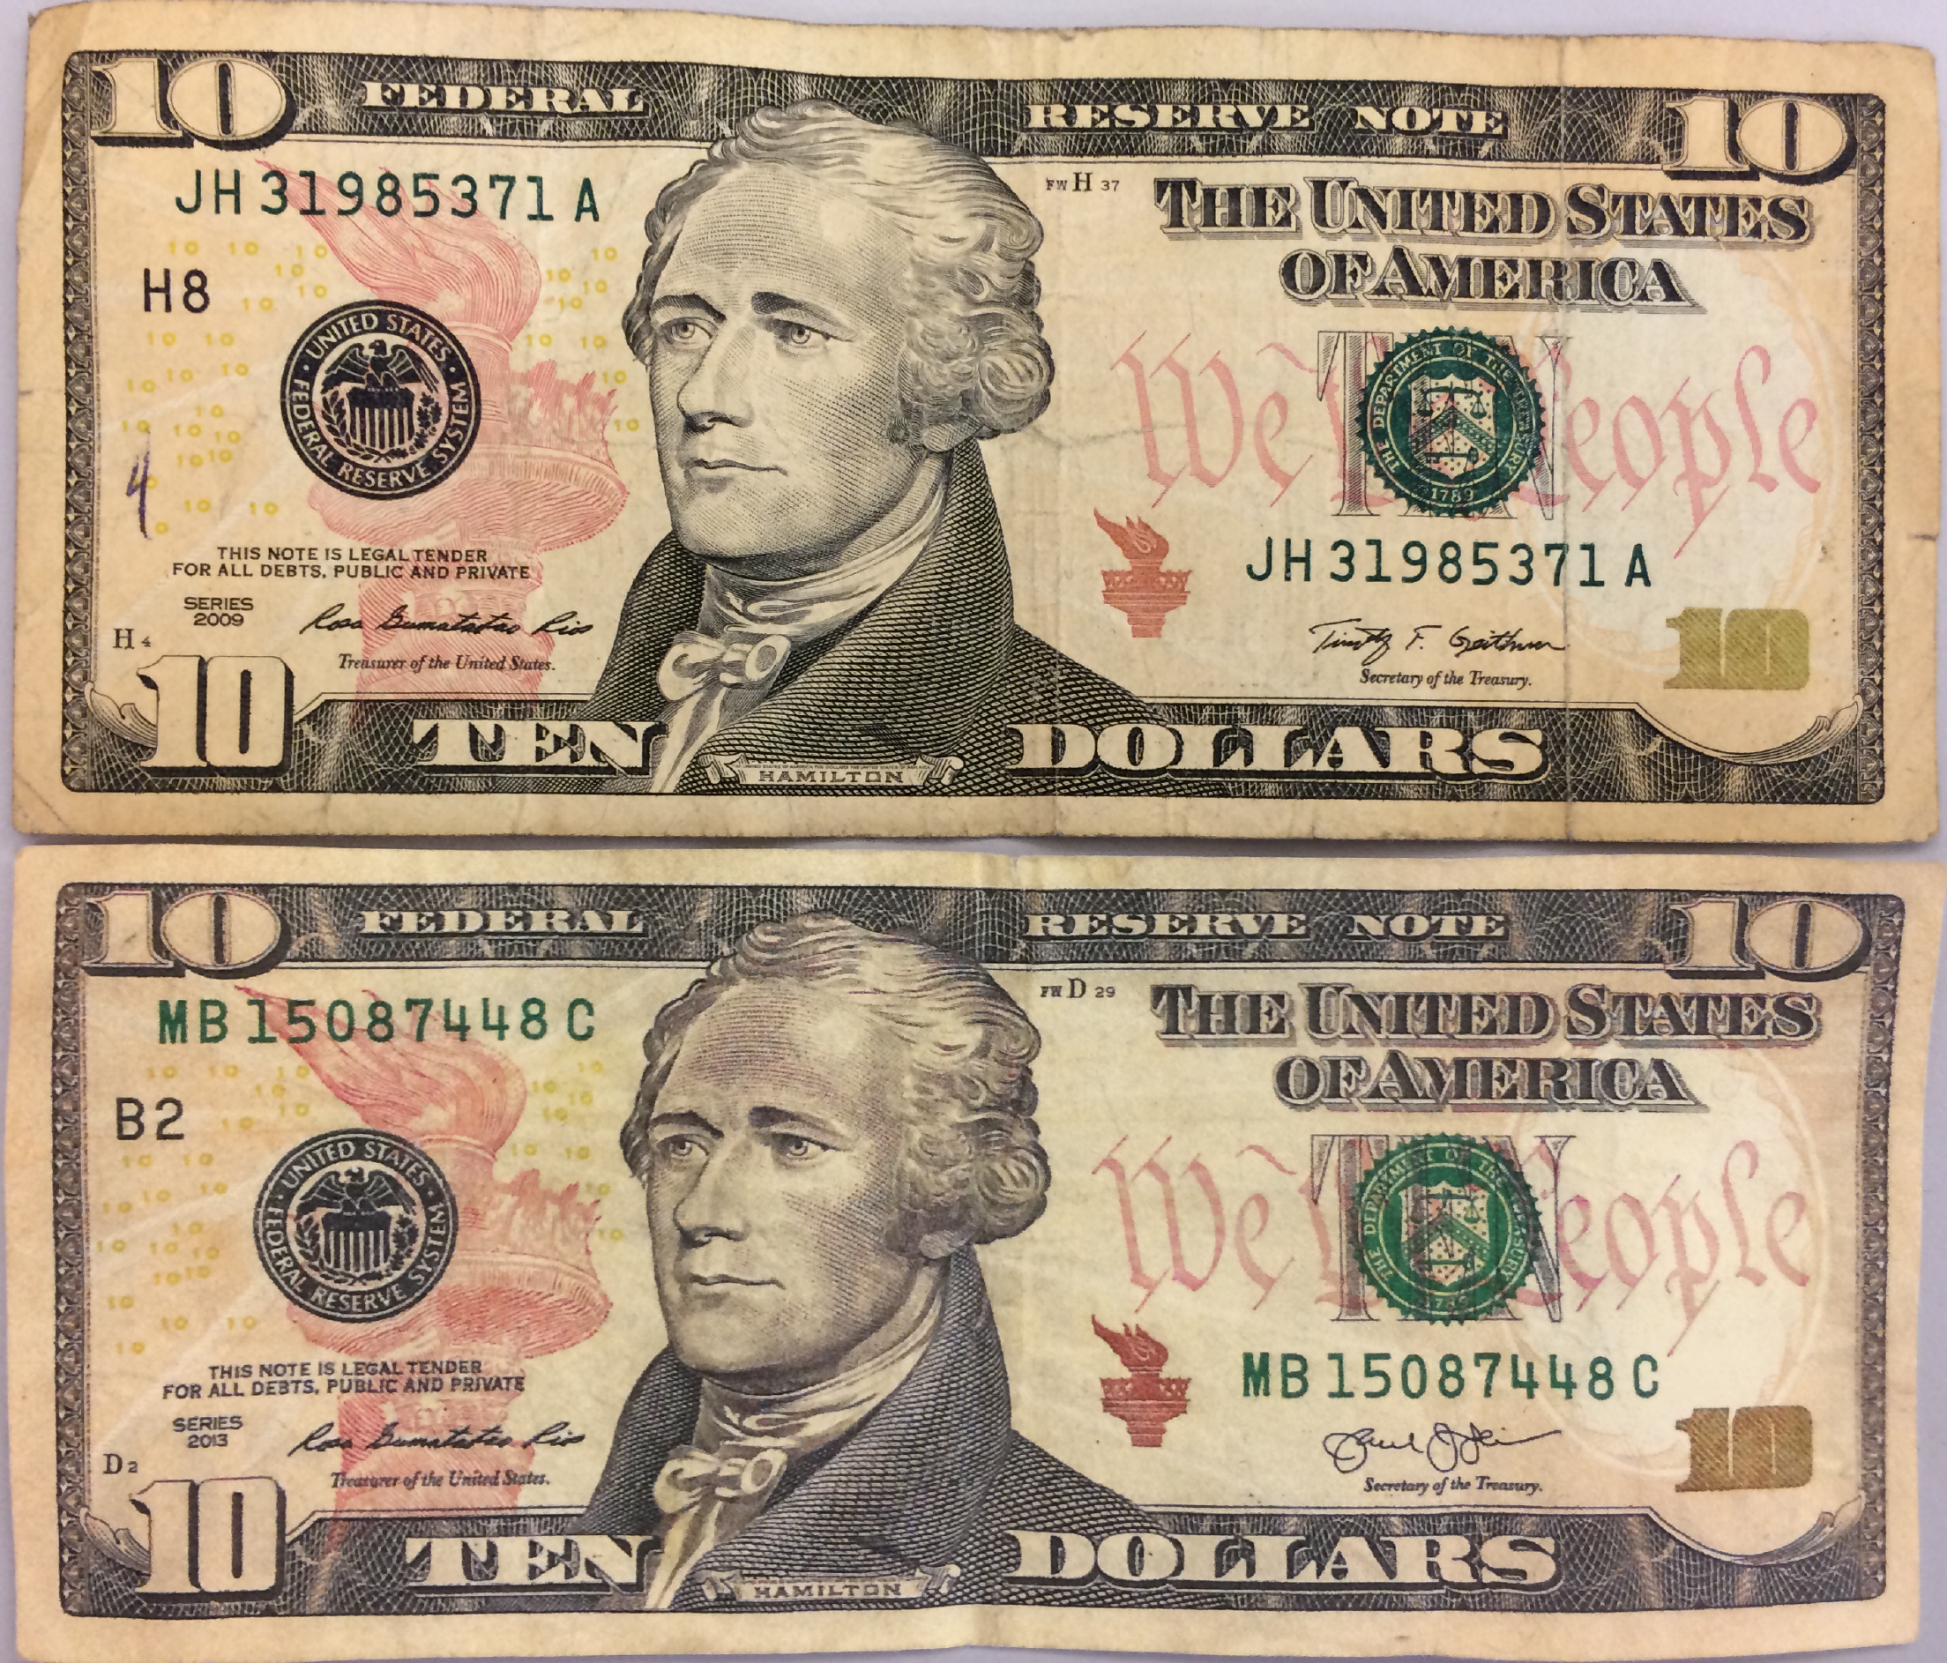
Where in the DNA should we look?
Photo credit:
https://www.cnbc.com/2015/09/02/can-you-find-the-forgery.html

Slide 14
Where in the DNA should we look?
COUNTERFEIT
Photo credit:
https://www.cnbc.com/2015/09/02/can-you-find-the-forgery.html

Slide 15
Where in the DNA should we look?
>Human Tubulin –Black? GCAGGTTCTCTTACATCGACCGCCTAAGAGTCGCGCTGTAAGAAGCAACAACCTCTCCTCTTCGTCTCCG CCATCAGCTCGGCAGTCGCGAAGCAGCAACCATGCGTGAGTGCATCTCCATCCACGTTGGCCAGGCTGGT GTCCAGATTGGCAATGCCTGCTGGGAGCTCTACTGCCTGGAACACGGCATCCAGCCCGATGGCCAGATGC CAAGTGACAAGACCATTGGGGGAGGAGATGATTCCTTCAACACCTTCTTCAGTGAGACGGGGGCTGGCAA GCATGTGCCCCGGGCAGTGTTTGTAGACTTGGAACCCACAGTCATTGATGAAGTTCGCACTGGCACCTAC CGCCAGCTCTTCCACCCTGAGCAACTTATCACAGGCAAAGAAGATGCTGCCAATAACTATGCCCGAGGGC ACTACACCATTGGCAAGGAGATCATTGACCTCGTGTTGGACCGAATTCGCAAGCTGGCCGACCAGTGCAC
Almost everywhere we look in our (human) genome, we all look the same
>Human Tubulin –White? GCAGGTTCTCTTACATCGACCGCCTAAGAGTCGCGCTGTAAGAAGCAACAACCTCTCCTCTTCGTCTCCG CCATCAGCTCGGCAGTCGCGAAGCAGCAACCATGCGTGAGTGCATCTCCATCCACGTTGGCCAGGCTGGT GTCCAGATTGGCAATGCCTGCTGGGAGCTCTACTGCCTGGAACACGGCATCCAGCCCGATGGCCAGATGC CAAGTGACAAGACCATTGGGGGAGGAGATGATTCCTTCAACACCTTCTTCAGTGAGACGGGGGCTGGCAA GCATGTGCCCCGGGCAGTGTTTGTAGACTTGGAACCCACAGTCATTGATGAAGTTCGCACTGGCACCTAC CGCCAGCTCTTCCACCCTGAGCAACTTATCACAGGCAAAGAAGATGCTGCCAATAACTATGCCCGAGGGC ACTACACCATTGGCAAGGAGATCATTGACCTCGTGTTGGACCGAATTCGCAAGCTGGCCGACCAGTGCAC
>Human Tubulin –Asian? GCAGGTTCTCTTACATCGACCGCCTAAGAGTCGCGCTGTAAGAAGCAACAACCTCTCCTCTTCGTCTCCG CCATCAGCTCGGCAGTCGCGAAGCAGCAACCATGCGTGAGTGCATCTCCATCCACGTTGGCCAGGCTGGT GTCCAGATTGGCAATGCCTGCTGGGAGCTCTACTGCCTGGAACACGGCATCCAGCCCGATGGCCAGATGC CAAGTGACAAGACCATTGGGGGAGGAGATGATTCCTTCAACACCTTCTTCAGTGAGACGGGGGCTGGCAA GCATGTGCCCCGGGCAGTGTTTGTAGACTTGGAACCCACAGTCATTGATGAAGTTCGCACTGGCACCTAC CGCCAGCTCTTCCACCCTGAGCAACTTATCACAGGCAAAGAAGATGCTGCCAATAACTATGCCCGAGGGC ACTACACCATTGGCAAGGAGATCATTGACCTCGTGTTGGACCGAATTCGCAAGCTGGCCGACCAGTGCAC

Slide 16
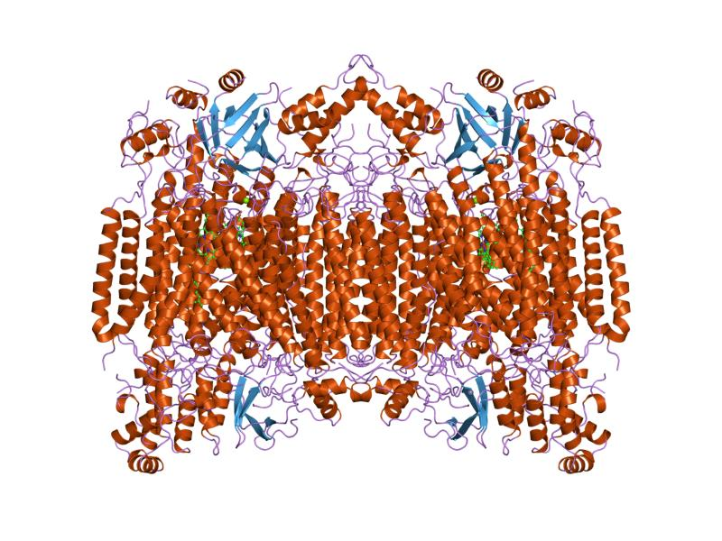
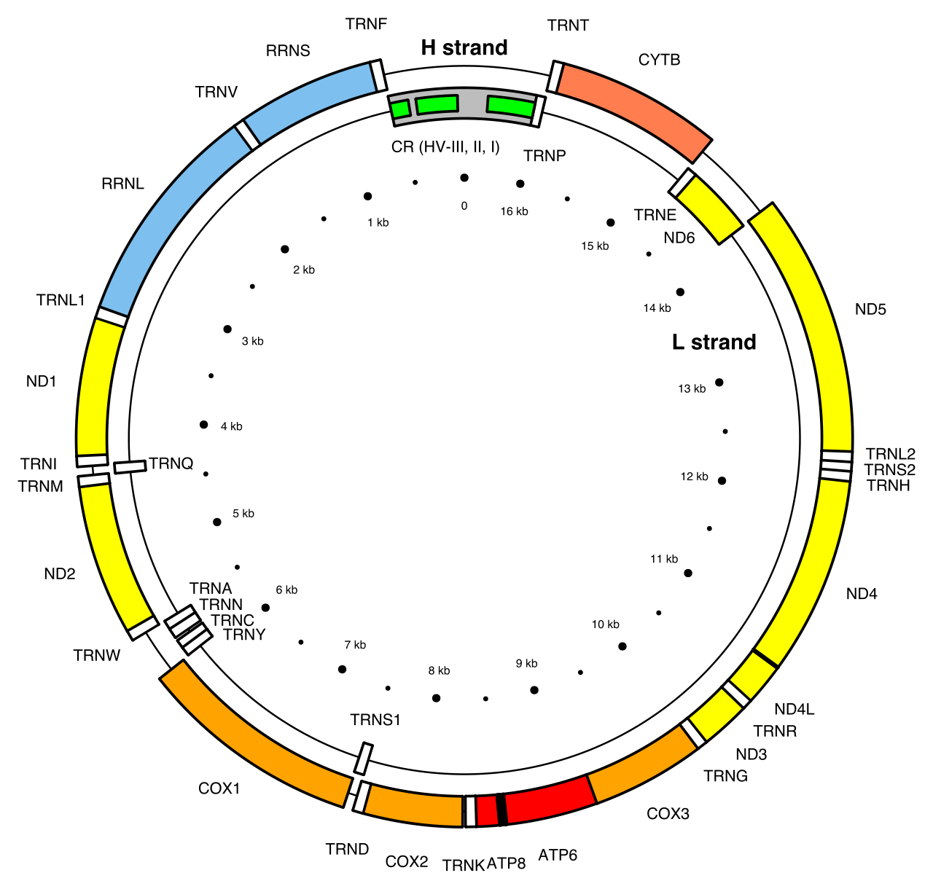
Cytochrome c oxidase I (COI)
Photo credit:
Structure: https://en.wikipedia.org/wiki/Cytochrome_c_oxidase_subunit_I#/media/File:PDB_1occ_EBI.jpg
Genome map:
Emmanuel Douzery; https://en.wikipedia.org/wiki/Cytochrome_c_oxidase_subunit_I#/media/File:Map_of_the_human_mitochondrial_genome.svg

Slide 17

Choosing a barcoding locus
There are many criteria that go in to selecting an appropriate locus (location in the genome) that can serve as a barcode.
Three of them include:
Universality
Discrimination
Robustness

Slide 18
Universality
Since barcoding protocols (typically) amplify a region of DNA by PCR, you need to choose a DNA sequence that every species has

Slide 19
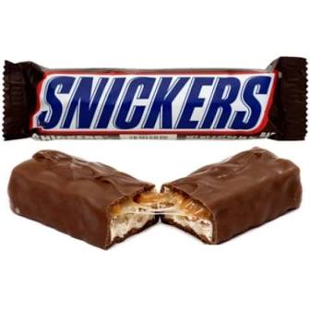
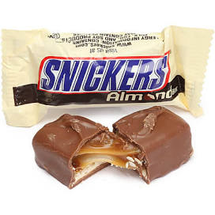
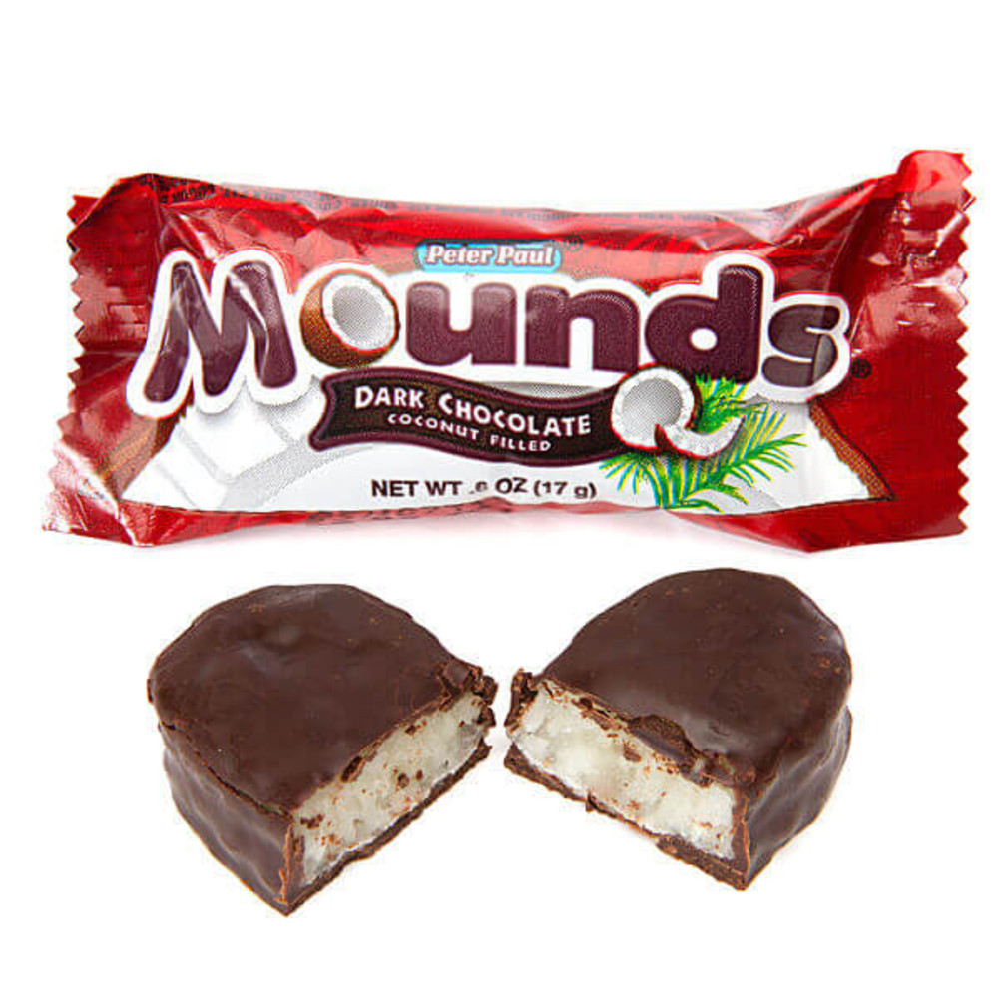
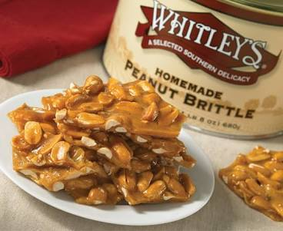
Universality
Since barcoding protocols (typically) amplify a region of DNA by PCR, you need to choose a DNA sequence that every species has

Slide 20
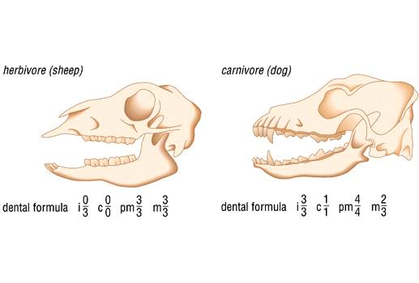
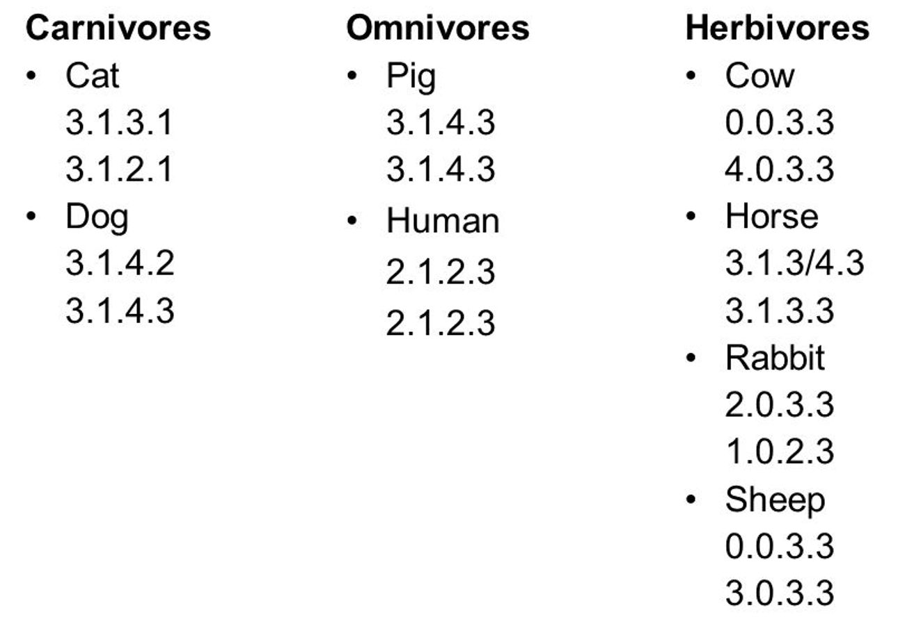
Universality
Since barcoding protocols (typically) amplify a region of DNA by PCR, you need to choose a DNA sequence that every species has
Photo credit:
Dental formula
https://slideplayer.com/slide/10972461/
Animal diagrams
https://vet-science.blogspot.com/2012/01/dentition-in-sheep-and-goat.html

Slide 21
Discrimination
Barcoding regions must be different for each species. Ideally you are looking for a single DNA locus which differs in each species

Slide 22

Discrimination
Barcoding regions must be different for each species. Ideally you are looking for a single DNA locus which differs in each species
Photo credit
Human hair
https://lewigs.com/human-hair-color-101/

Slide 23
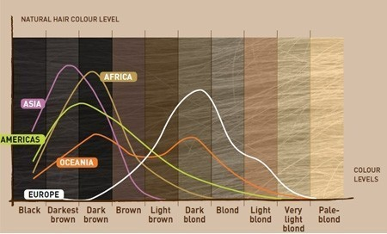
Discrimination
Barcoding regions must be different for each species. Ideally you are looking for a single DNA locus which differs in each species
Photo credit
http://loreal-dam-videos-corp-en-cdn.brainsonic.com/corpen/20160330pm/20160330-170533-c4bb4cb7/picture_photo_3eadc4.jpg

Slide 24
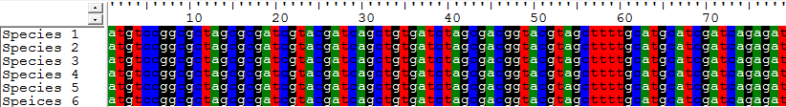
Discrimination (but not too much)
Fail: Sequence is completely conserved, good for PCR, but uninformative as barcode

Slide 25
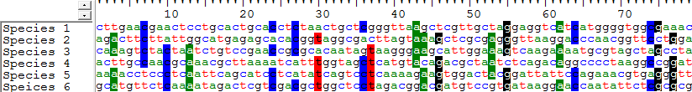
Discrimination (but not too much)
Fail: Sequence shows no conservation, impossible for PCR, but good as barcode

Slide 26
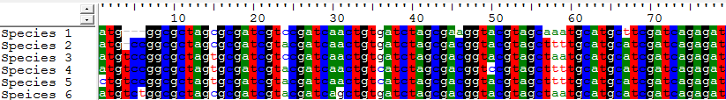
Discrimination (but not too much)
Win: Sequence shows some (ideally ~70%) conservation, good for PCR, good as barcode

Slide 27
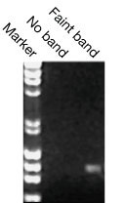
Robustness
Since barcoding protocols (typically) amplify a region of DNA by PCR, also need to select a locus that amplifies reliably and sequences well
Photo credit
https://www.bio-rad.com/es-mx/applications-technologies/pcr-troubleshooting?ID=LUSO3HC4S

Slide 28
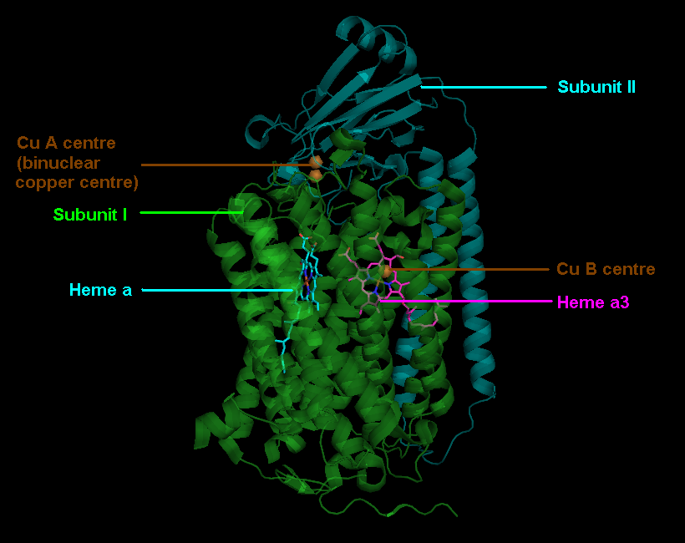
Choosing a barcoding locus
Cytochrome Oxidase C subunit 1 (COI):
Universal
Discriminating
Robust
Photo credit:
https://en.wikipedia.org/wiki/Cytochrome_c_oxidase#/media/File:Cmplx4.PNG

Slide 29
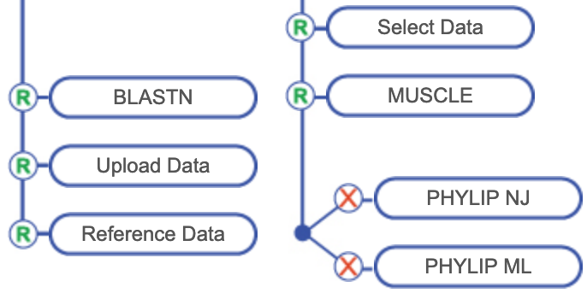
Reference data and phylogenetics

Slide 30
Experimental components/design
Materials
We have DNA from unknown mosquito samples
We can obtain DNA from known samples
Hypothesis
We can use computational methods (BLAST/phylogenetic analysis) to infer the species
Controls
We have sensitivity controls (sequence quality, BLAST parameters)
We have outgroup sequences (non-mosquito, negative controls) and known samples (positive controls)

Slide 31
Intro to Multiple Sequence Alignment

Slide 32

Multiple sequence alignment
To compare sequence features (nucleotides, amino acids, etc.) we need to line them up
Photo credit:
https://www.pexels.com/photo/jigsaw-puzzle-1586950/

Slide 33
Warning: Analogy (useful for discussion but not the whole picture)

Slide 34
Multiple sequence alignment
THEFISHISINTHEWATER
TH’FESHISINTH’WATER
DEVISISINHETWATER
DIEVISISINDIEWATER
DERFISCHISTIMWASSER
FISKINERÍVATNI

Slide 35
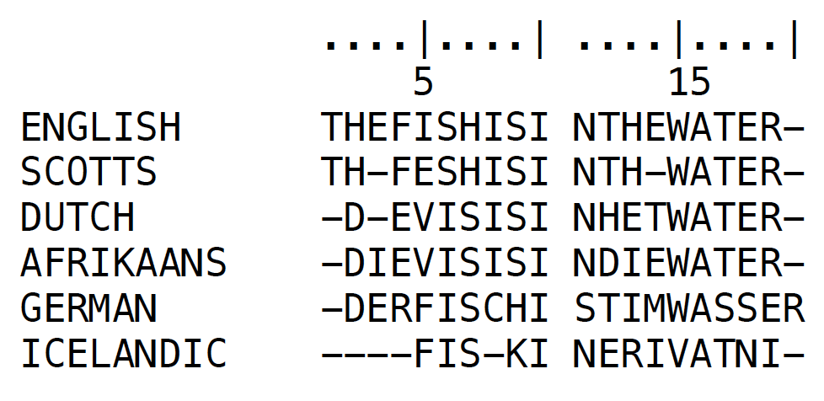
Multiple sequence alignment

Slide 36
Multiple sequence alignment
Colored at 60% identity

Slide 37
Multiple sequence alignment
There is more information here …

Slide 38
Multiple sequence alignment
There is more information here …

Slide 39
Multiple sequence alignment
There is more information here …

Slide 40
Multiple sequence alignment
There is more information here …

Slide 41
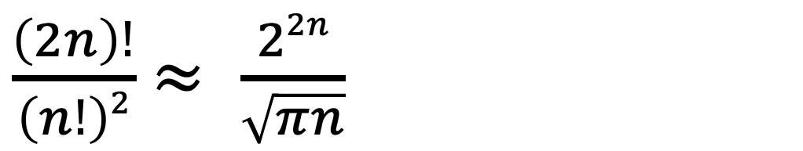
Multiple sequence alignment
Number of (global) alignments for 2 sequences of length n
$\frac{\left(2n\right)!}{\left(n!\right)2}$ $≈ \frac{22n}{\sqrt{πn}}$
Photo credit:
https://www.pexels.com/photo/jigsaw-puzzle-1586950/

Slide 42
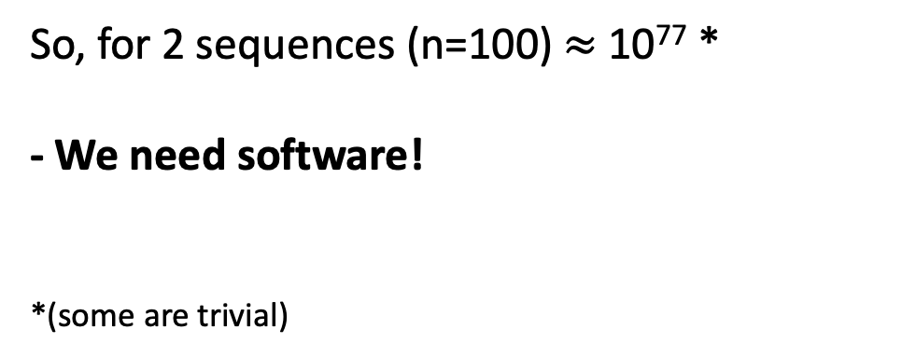
Multiple sequence alignment
Number of (global) alignments for 2 sequences of length n
$\frac{\left(2n\right)!}{\left(n!\right)2}$ $≈ \frac{22n}{\sqrt{πn}}$
So, for 2 sequences (n=100) $≈$ 10⁷⁷ *
- We need software!
*(some are trivial)
Photo credit:
https://www.pexels.com/photo/jigsaw-puzzle-1586950/

Slide 43
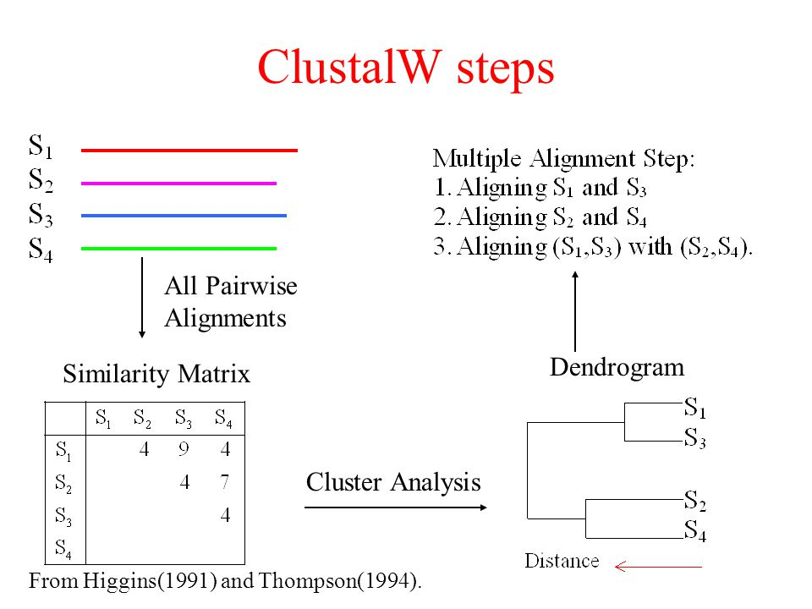
CLUSTAL alignment algorithm
Photo credit:
https://slideplayer.com/slide/5155996/

Slide 44
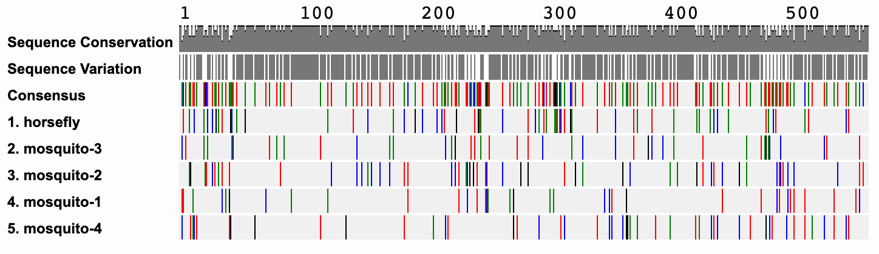
Multiple sequence alignment

Slide 45
Making phylogenetic trees

Slide 46
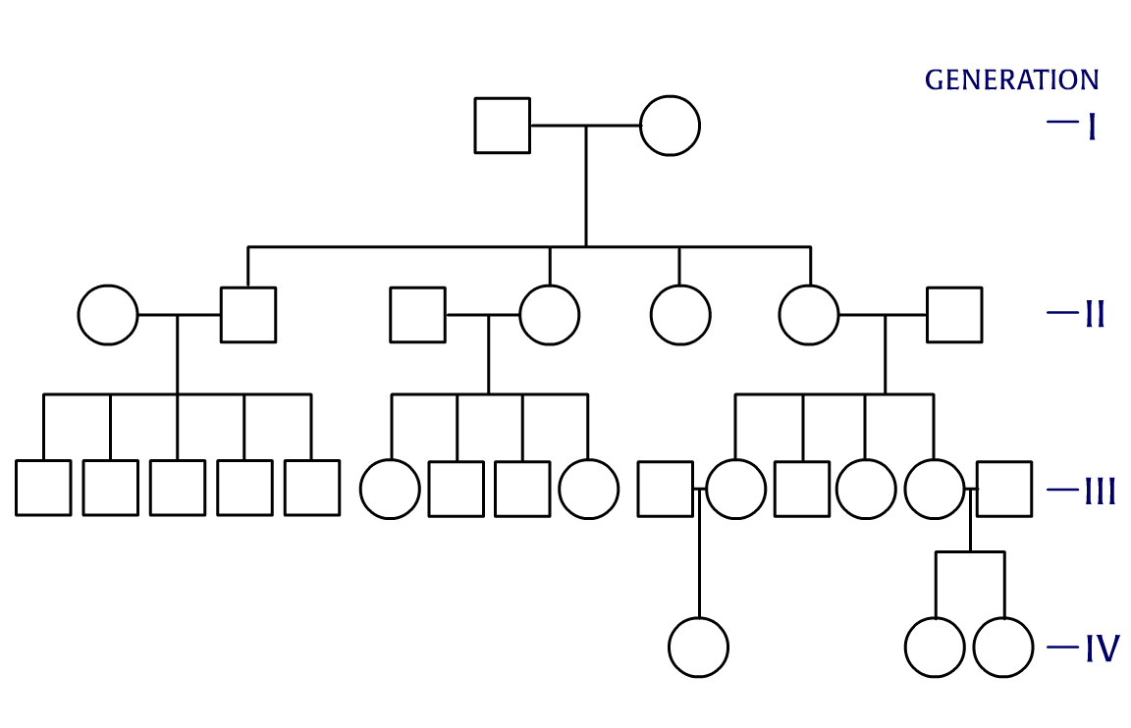
Tree relationships

Slide 47
Tree relationships
This is not a phylogenetic tree

Slide 48
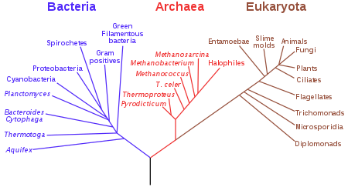
Phylogenetic trees
A phylogenetic tree is a hypothesis about how
species may be related
Photo credit
https://en.wikipedia.org/wiki/File:Phylogenetic_tree.svg

Slide 49
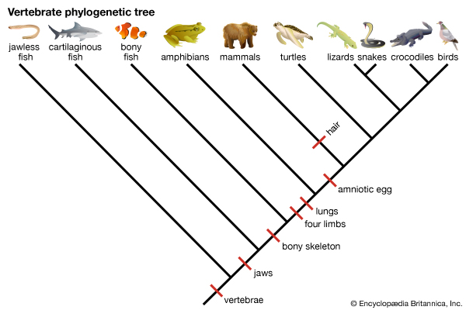
Phylogenetic trees
Trees can be created from
(and therefore reflect)
characteristics/traits
Photo credit
https://kids.britannica.com/students/assembly/view/235364

Slide 50
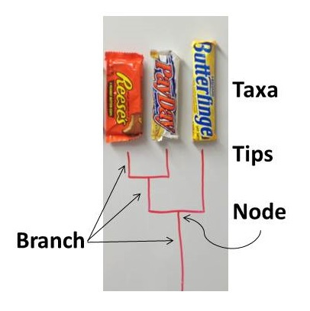
Phylogenetic trees
Trees can be created from
(and therefore reflect)
characteristics/traits
Photo credit
https://wildlifesnpits.wordpress.com/2014/03/22/understanding-phylogenies-terminology/

Slide 51
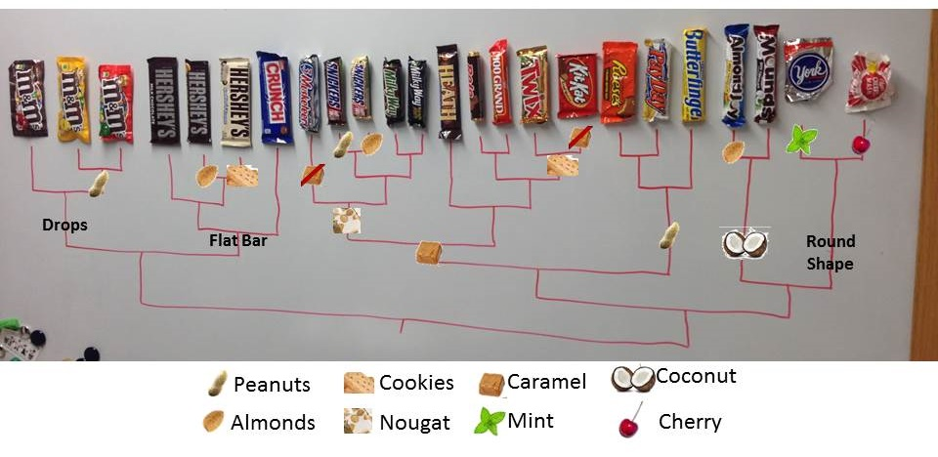
Phylogenetic trees
Photo credit
https://wildlifesnpits.wordpress.com/2014/03/22/understanding-phylogenies-terminology/

Slide 52
Phylogenetic trees
Tree Vocabulary
Taxa: Individual species
Tip: The endpoints of a tree
Node: A point where branches split
Branch: Any collection after a node
Photo credit
https://wildlifesnpits.wordpress.com/2014/03/22/understanding-phylogenies-terminology/

Slide 53
Tree experiments
Experiment 1: Unknown Mosquitos and outgroup
Method: neighbor joining
Experiment 2: Unknown Mosquitos and outgroup
Method: maximum likelihood
Experiment 3: Unknown Mosquitos + BLAST hits and outgroup
Method: neighbor joining
Experiment 4: Unknown Mosquitos + BLAST hits and outgroup
Method: maximum likelihood

Slide 54
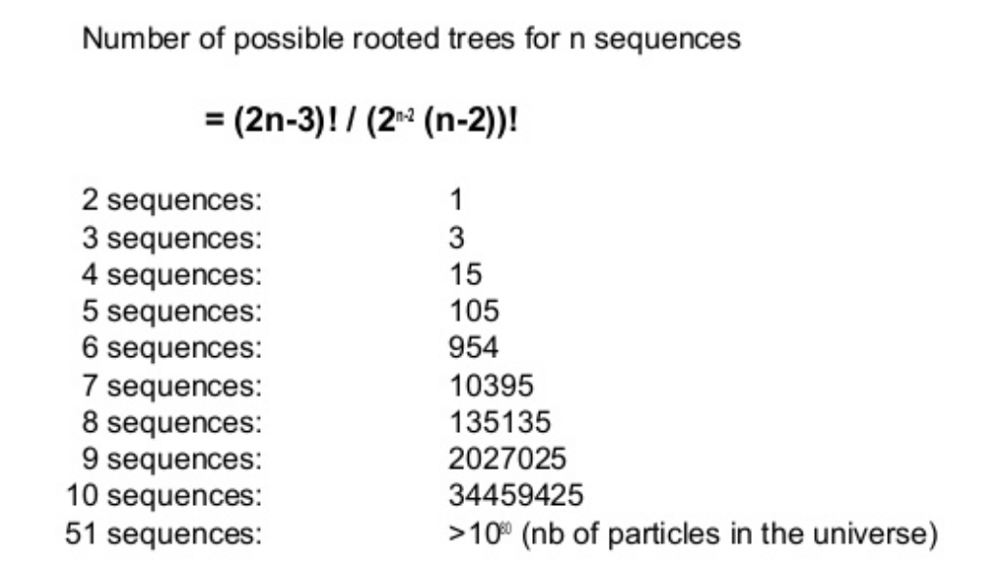
Trees are also computationally intensive
Photo credit:
https://www.slideshare.net/sebastiendelandtsheer/phylogenetics1

Slide 55
Tree building methods
There is no one “best” method

Slide 56
Tree building methods
There is no one “best” method
Neighbor joining:
“distance-based” method of tree building

Slide 57
Tree building methods
There is no one “best” method
Neighbor joining:
“distance-based” method of tree building
a matrix of the sequences is created based on distance between each pair of sequences in multiple alignment

Slide 58
Tree building methods
There is no one “best” method
Neighbor joining:
“distance-based” method of tree building
a matrix of the sequences is created based on distance between each pair of sequences in multiple alignment
distance is related to the number of mismatches between the sequences

Slide 59
Tree building methods
Bootstrap values (how we evaluate NJ trees):
columns in the sequence alignment randomly resampled to make many new alignments (DNA subway does this 100x)

Slide 60
Tree building methods
Bootstrap values (how we evaluate NJ trees):
columns in the sequence alignment randomly resampled to make many new alignments (DNA subway does this 100x)
a matrix of the sequences is created

Slide 61
Tree building methods
Bootstrap values (how we evaluate NJ trees):
columns in the sequence alignment randomly resampled to make many new alignments (DNA subway does this 100x)
a matrix of the sequences is created
each bootstrap value is the number of times that particular relationship appears in the 100 resampled trees

Slide 62
Tree building methods
Bootstrap values (how we evaluate NJ trees):
columns in the sequence alignment randomly resampled to make many new alignments (DNA subway does this 100x)
a matrix of the sequences is created
each bootstrap value is the number of times that particular relationship appears in the 100 resampled trees
Values of 70 and above are “plausible”; above 95 considered highly supported

Slide 63
Tree building methods
Maximum likelihood:
Attempts to take into account observed patterns of how nucleotides and amino acids change over time. For instance, mutations from C to T are more common than mutations of C to A.

Slide 64
Tree building methods
Maximum likelihood:
Attempts to take into account observed patterns of how nucleotides and amino acids change over time. For instance, mutations from C to T are more common than mutations of C to A.
The tree with highest overall likelihood score is accepted as the best estimate of the relationships between sequences.

Slide 65
Tree building methods
Maximum likelihood:
Attempts to take into account observed patterns of how nucleotides and amino acids change over time. For instance, mutations from C to T are more common than mutations of C to A.
The tree with highest overall likelihood score is accepted as the best estimate of the relationships between sequences.
The length of the branches between nodes is also a measure of the confidence of the relationships. Very short branches separating sequences have lower confidence and the relationships are less certain, while longer branches are better supported.

